Slide 1

Pre-Submission Seminar on Web Based Library Management System
Presented By
Pankaj Bankar
Guided By
Asst. Prof. Ratnesh K. Choudhary
Department of Computer Science & Engineering
S. B. JAIN INSTITUTE OF TECHNOLOGY MANAGEMENT AND RESEARCH,NAGPUR
An Autonomous Institute, Affiliated to RTMNU, Nagpur

Slide 2
Contents
Problem Statement & Objectives
Introduction
System Design
Developed Modules
Modules Description
Screenshots
Technology Used
Advantages & Applications
Conclusion
Future scope
Participation Summary
References
S. B. Jain Institute of Technology Management and Research
2

Slide 3
Problem Statement & Objectives
Problem Statement:
The problem faced is that library users require an efficient method to find a specific book or keyword(s) within a book given a continuously expanding library.
To overcome this problem Library Management System is introduce.
Objectives
To reduce the Paper work for library system.
The main purpose of this system is to manage library daily operation efficiently.
It is also created to ensure that the library items are stored properly in order to maintain their security.
S. B. Jain Institute of Technology Management and research
3

Slide 4
Introduction
Library management system is all about organizing, managing the library and library-oriented tasks.
It also involves maintaining the database of entering new books and the record of books that have been retrieved or issued, with their respective dates.
The main aim of this project is providing an easy to handle and automated library management system. This project also provides features and interface for maintaining librarian’s records, student’s history of issue and fines.
The owner can easily update, delete and insert data in the database with this project .The following are some of the features provided by this project.
S. B. Jain Institute of Technology Management and research
4

Slide 5
Literature Survey
Websites / Paper / Article | Reviews / Findings
Foreign Related Literature Central Library. | The central Library which is called as mkce central Library, is one of the best equipped library in terms of facilities, books, back volumes, journals and non-book materials like CD’s, Audio cassettes etc… is functioning in mkce Campus in Thalavapalayam, Karur. The Library started its service on 2000 as a part of mkce.The fully computerized Library Information Systems helps the staff and students tremendously in day-to-day operations.
2. Integrated Library Systems. ERIC Digest. | An automated library system usually consists of a number of functional modules, such as acquisitions, circulation, cataloging, serials, and an OPAC (Online Public Access Catalog). An “integrated” library system is an automated system, as described above, in which all of the functional modules share a common bibliographic database. The National Library of Medicine used the term “integrated” in referring to a system in which all automated library functions are processed against a single, master bibliographic file (Goldstein & Dick, 1980).

Slide 6
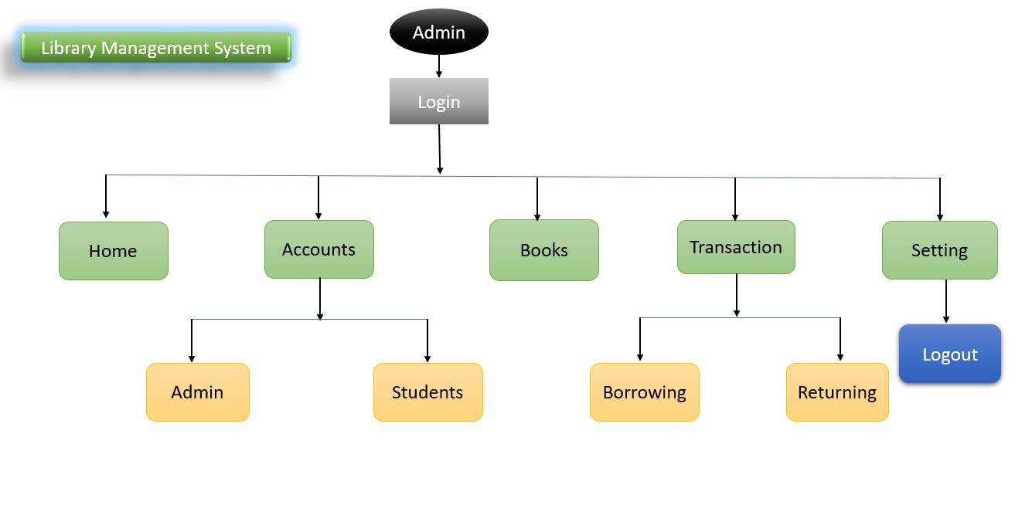
System Design: Flowchart
S. B. Jain Institute of Technology Management and research
6

Slide 7
Developed Modules
Admin Module:
In this module we first create login page and after successful login we have
option like Home , Accounts, Books , Transaction and Setting tabs in the Dashboard.
We have to click on Account Tab for accessing admin and student Section.
Then click on Student tab for Adding the students and his information in the library system.
After that , click on Books tab for adding Books in the Library. Or to view the no. of
books present in the library.
Then , go to the Transaction tab for Borrowing the books (or) Returning books .
If you returned the book you also see the Date on which book is return .
At last , for logout from system go to the Setting tab and click on the Logout tab.
S. B. Jain Institute of Technology Management and research
7

Slide 8
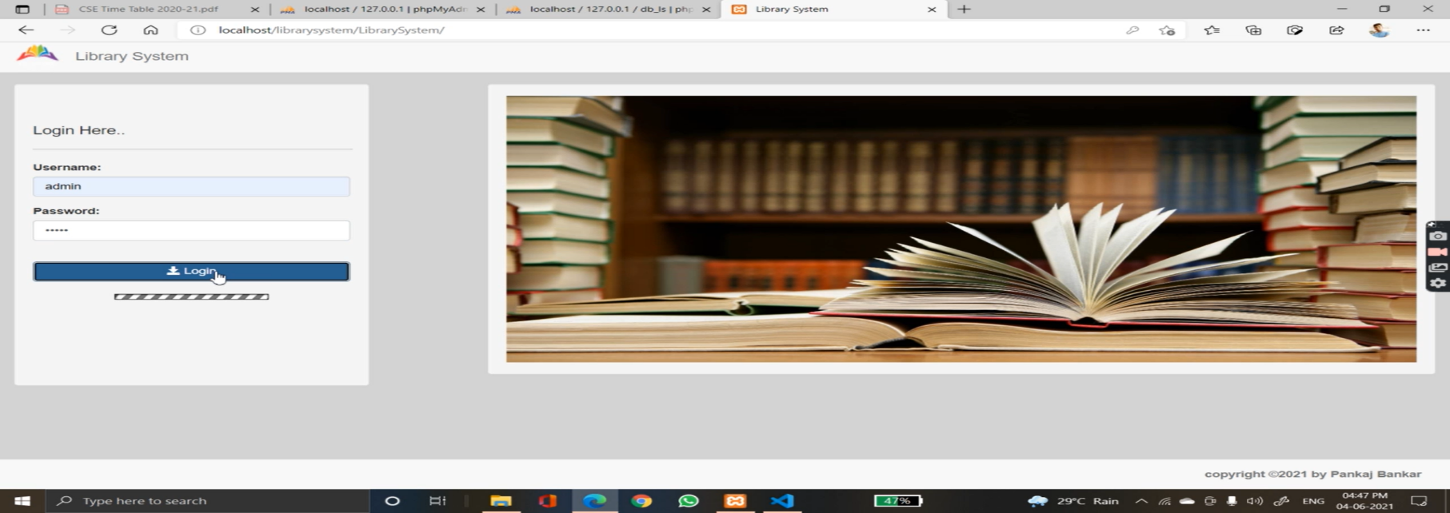
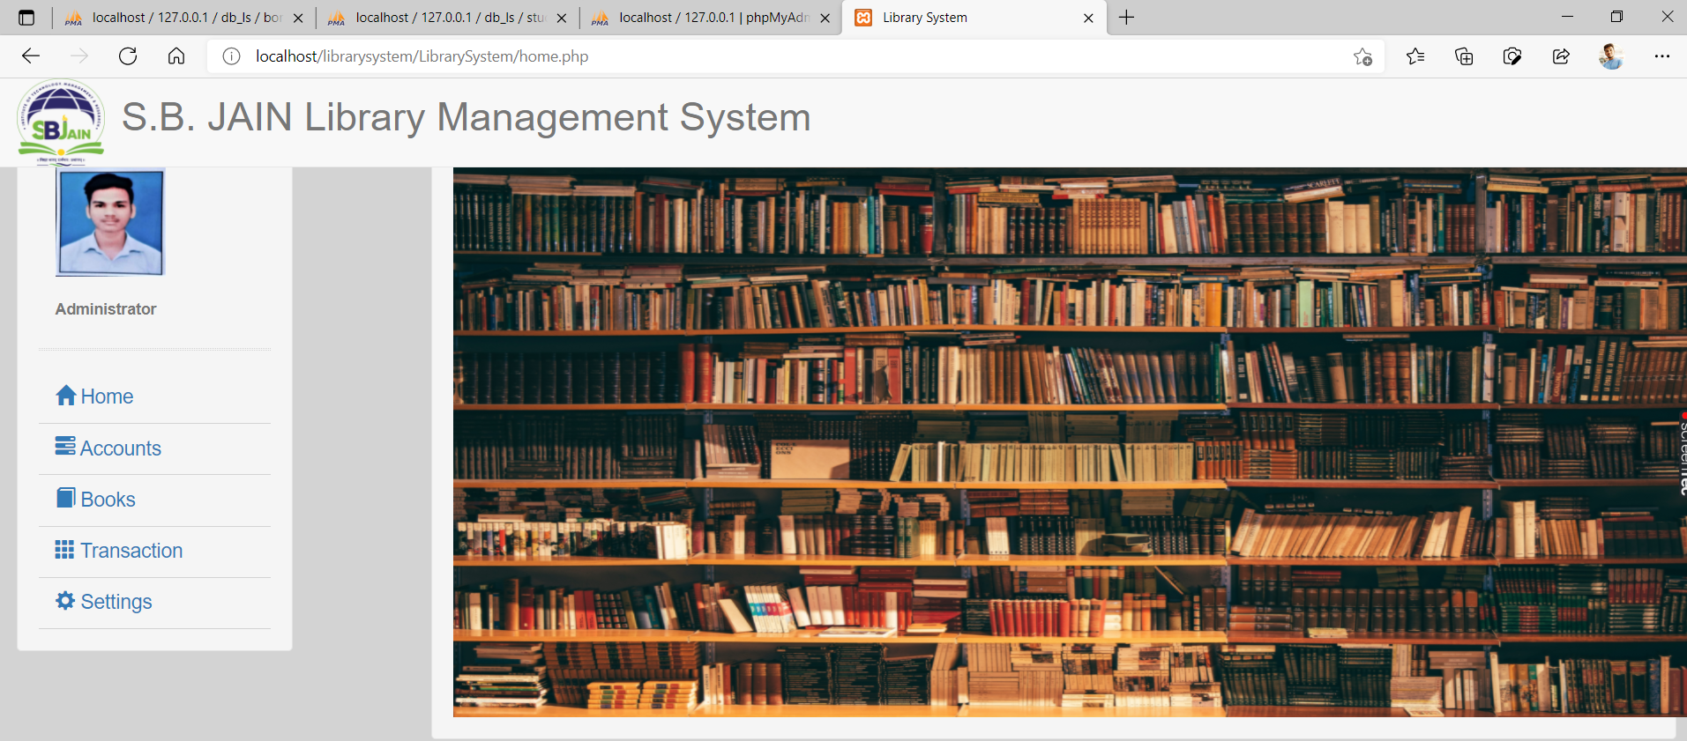
ScreenShots
S. B. Jain Institute of Technology Management and research
8

Slide 9
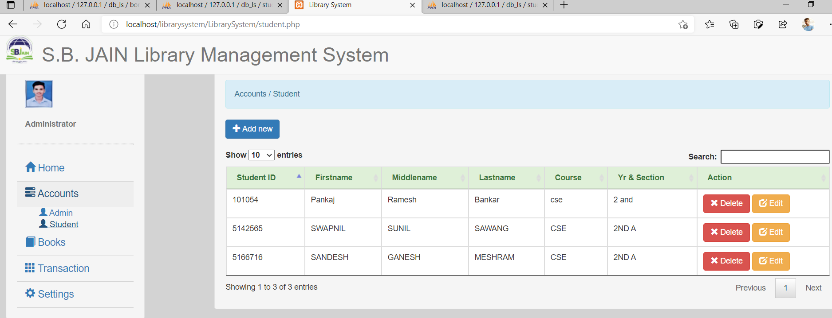
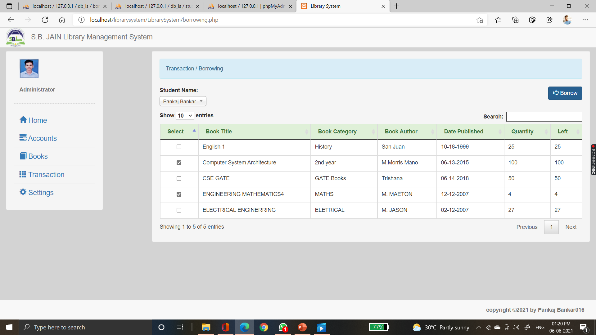

Slide 10
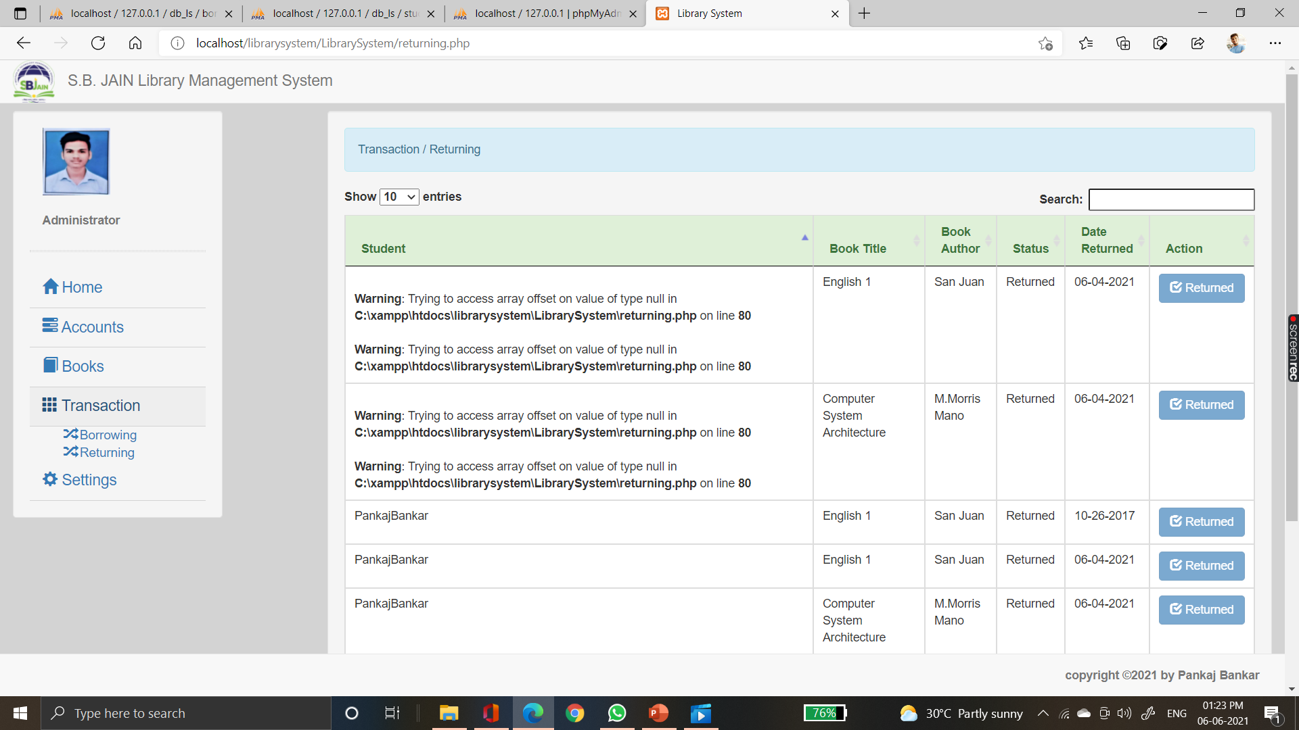
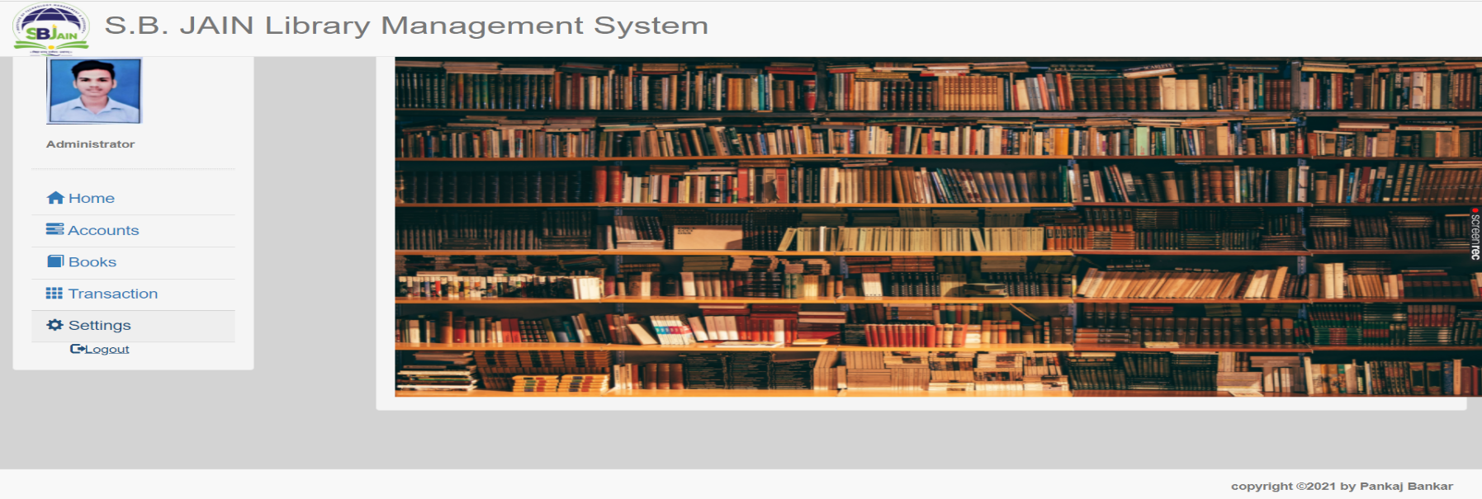

Slide 11
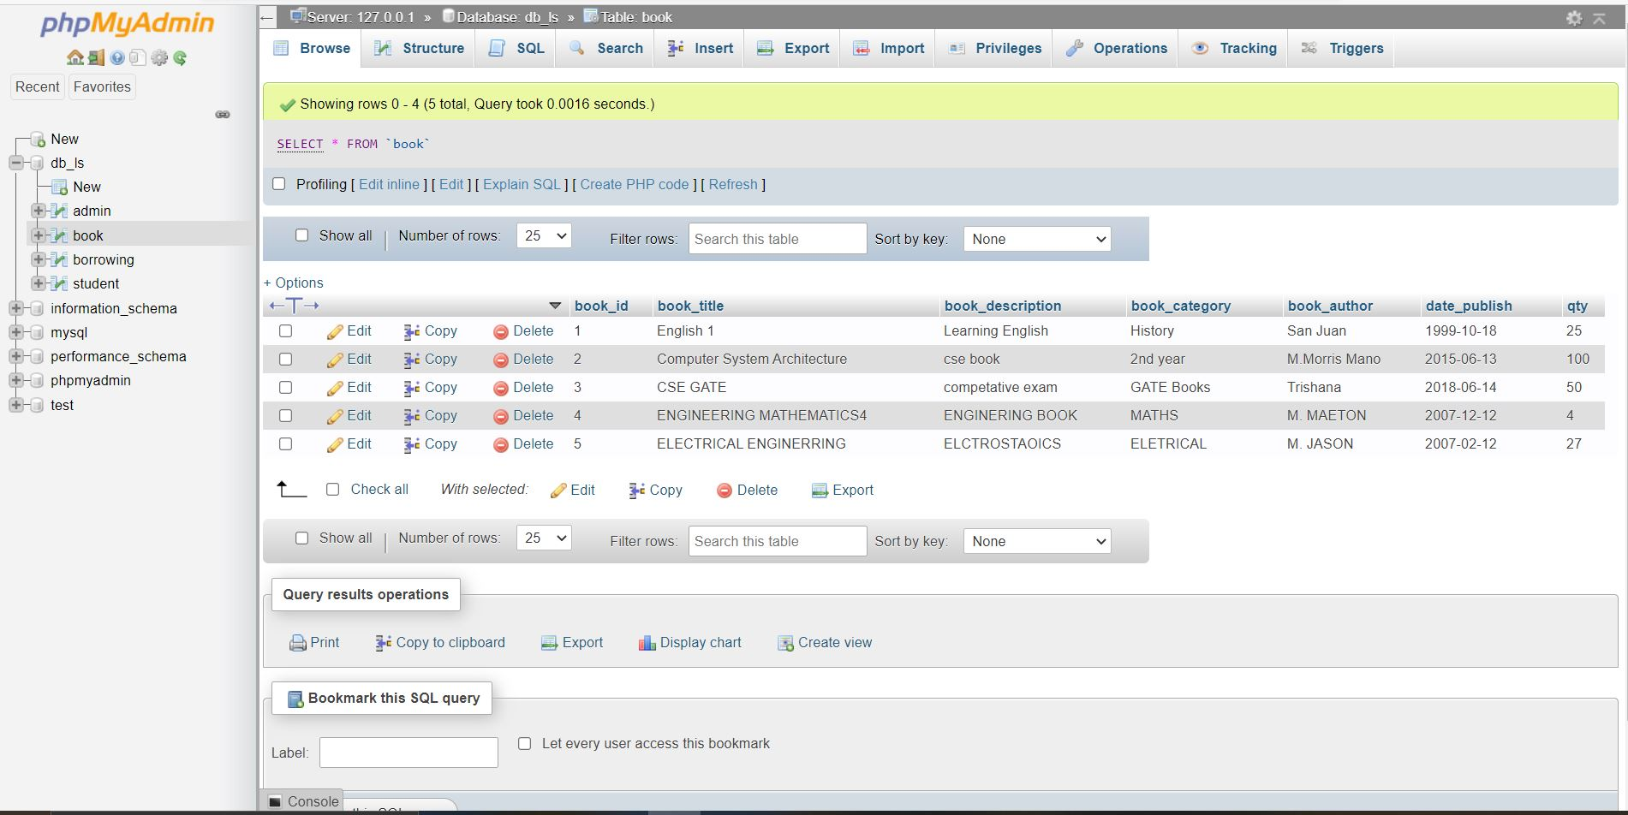

Slide 12
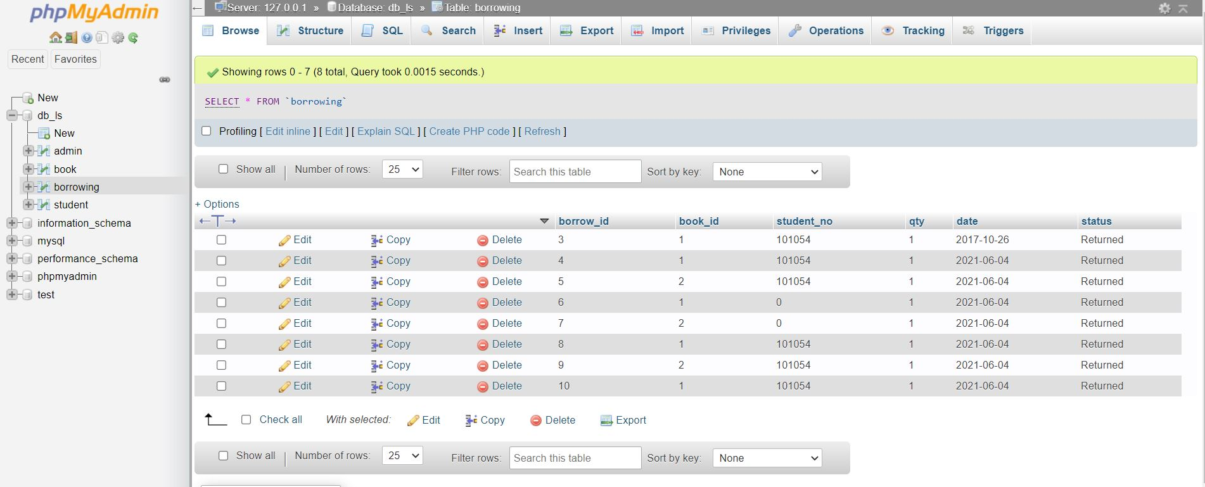
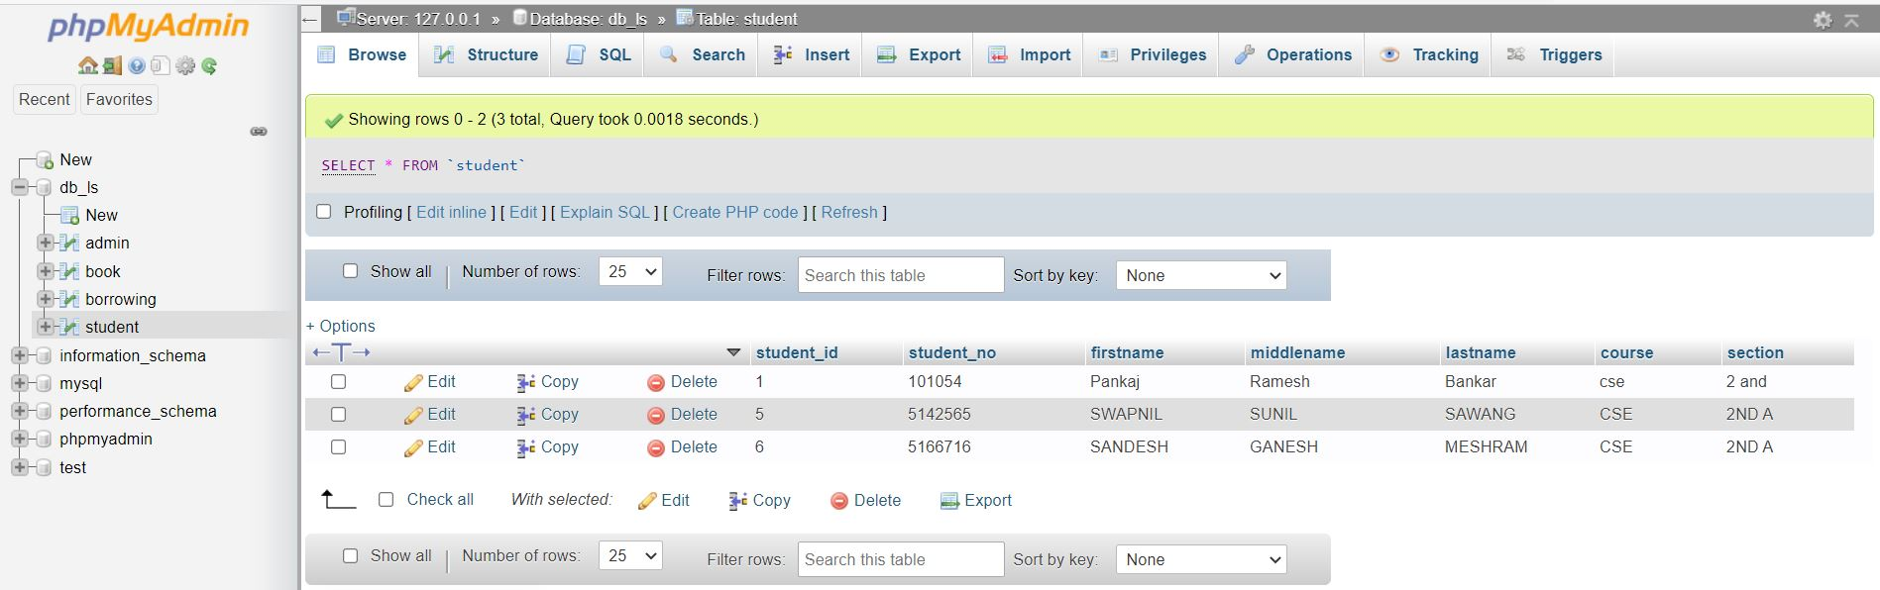

Slide 13
Technology Used
Front End:
HTML, Java, CSS
Back End:
PHP, Boos Strap .
IDE: XAMPP Server
S. B. Jain Institute of Technology Management and research
13

Slide 14
Advantages & Applications
It is user-friendly software.
It is cost-effective and easy to install.
It helps in maintaining records.
One can track any information through this system.
It increases the efficiency.
It saves human effort and time.
It reduces the chances of error.
It acts as an anti-theft.
Application:
It is used in any education institute can make use of it for providing information about author, content of the available books.
S. B. Jain Institute of Technology Management and research
14

Slide 15
Conclusion
We have entirely completed our project, and our proposed system is designed to reduce the time and save the efforts of the faculties from maintaining huge amount of records.
The project LIBRARY MANAGEMENT SYSTEM is for computerizing the working in a library.
The software takes care of all the requirements of an a library and is capable to provide easy and effective storage of information related to books & users. During the development of the project we understood the importance of individual and team work while project development and management.
While presenting in various seminar we have enhanced our communication skills and displayed professional ethics which will result in lifelong ethics.
S. B. Jain Institute of Technology Management and research
15

Slide 16
Future Scope
DESCRIPTION OF FEATURE :
This feature is found in book maintenance part .
we can search book based on book id , book name , publication or by author name.
Any education institute can make use of it for providing information about author, content of the available books.
It can be used in offices and modifications can be easily done according to requirements.
S. B. Jain Institute of Technology Management and research
16

Slide 17
Thank You

